Slide 1
Resume Analysis using NLP
Presented By:
Jahnavi Lanka
Akanshya Meher
Puja Sonawane

Slide 2
Motivation
Almost 90% of companies use ATS (Application Tacking System) to filter suitable candidates automatically from the application pool.
It is important for candidates to understand how ATS works in order to land a job in the competitive market.
Our system will aid employees and candidates to analyze resumes just like how a real-world ATS analyzes it.
We will be addressing this problem by presenting similar analysis to any applicant which will help them to improve the resume according to employers’ preferences and standards.

Slide 3

Problem Significance
It is very important to draft an effective resume that matches the skills that are provided in job description by the companies.
With the current pandemic going on it has become crucial than ever to prepare a resume that matches the job description for respective positions and to be called for an interview.
In this project, we have used using NLP (Natural Language Processing) techniques for text summarization and skill wise classifications.

Slide 4
Related Works
There exist several similar systems available right now. Two comparable papers can be found via the following link: https://oaktrust.library.tamu.edu/bitstream/handle/1969.1/154963/GUO-THESIS-2015.pdf?sequence=1 https://core.ac.uk/download/pdf/55305289.pdf
The existing resume ranking system uses Ranking algorithms and other implementation differences whereas our resume analysis system is mainly depending on natural language processing.
We have used pattern matching, summarization, techniques with help of libraries like numpy, pandas, spacy, docx2txt, CountVectorizer, nltk, textract, pypdf2, genism, re, and measures like cosine similarity, jaccard.

Slide 5
Techniques and Algorithms
Built a model that scans a group of users resume and highlights skills/technologies using bar chart and pie chart that makes employers to choose a person with highest skill they require through detailed visualizations.
Our model is beneficial for applicants and employers to check similarity among job description and resumes.
Other features we included are spell checker and summarization of the resume.
We have used libraries like Phrase Matcher from spaCy to match the phrases from the resume with the keyword dictionaries, pyPDF2 and decx2txt to extract information from the resumes that are in PDF and Word formats respectively, gensim for similarity retrieval for summarization.

Slide 6

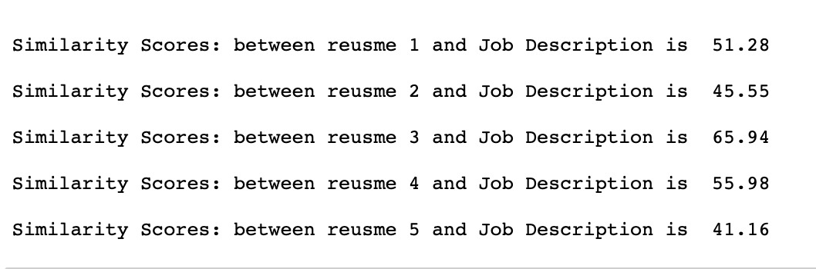
Count Vectorizer and Cosine Similarity

Slide 7

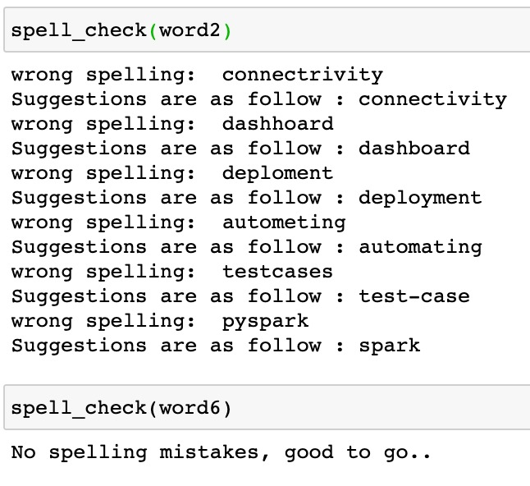
Spell Checker

Slide 8
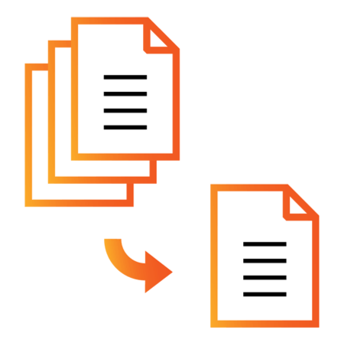
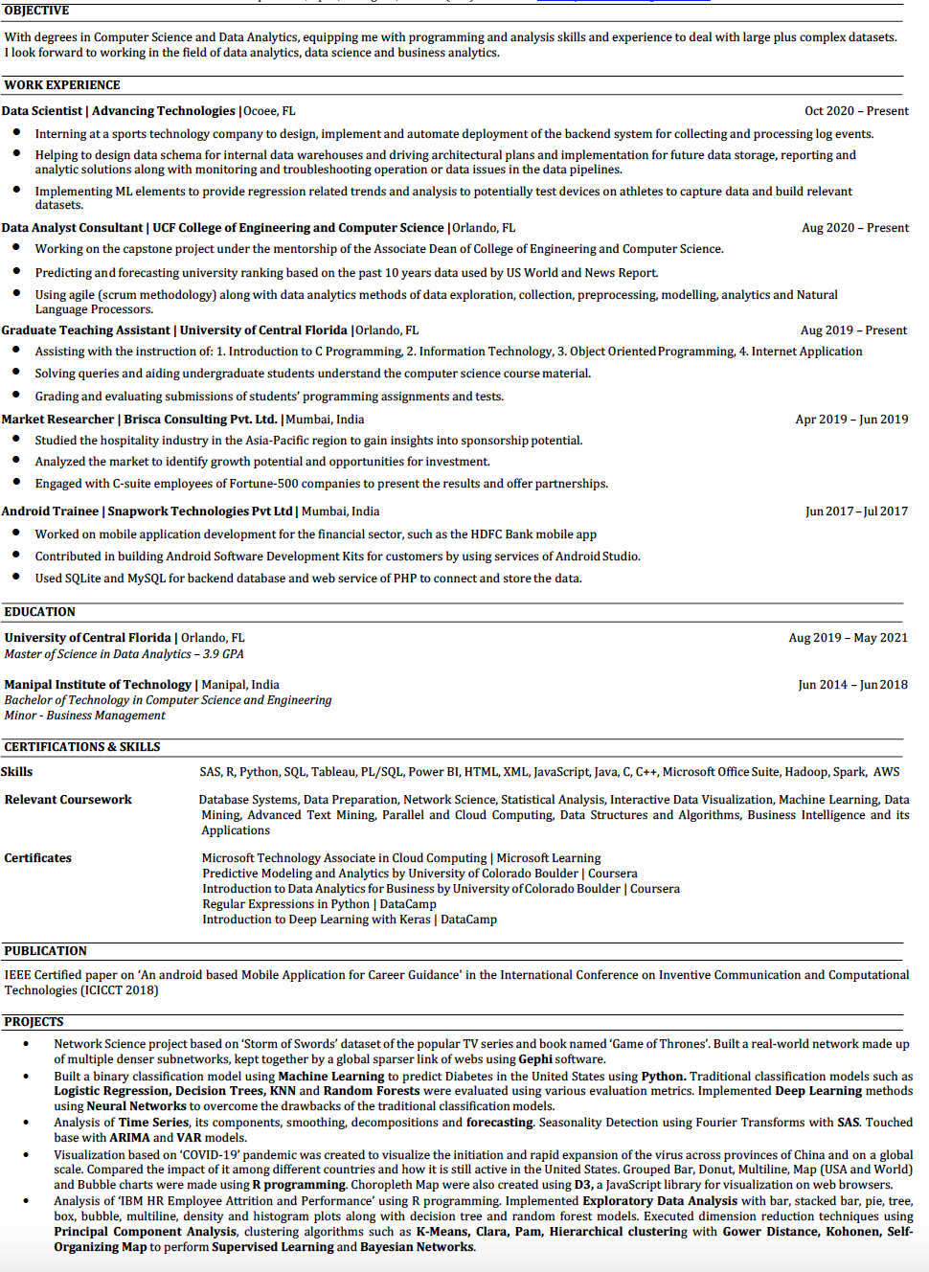
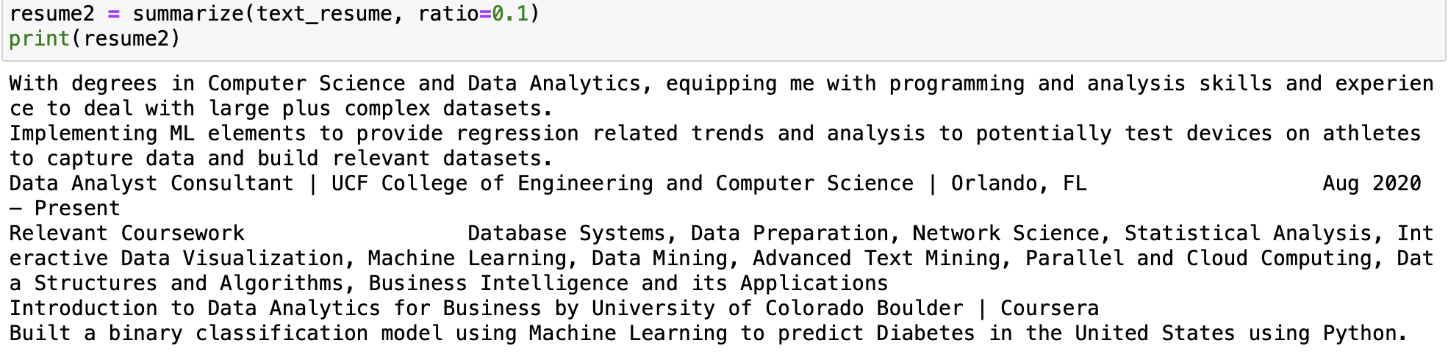
Text Summarization
Original Document
Summarized Document

Slide 9

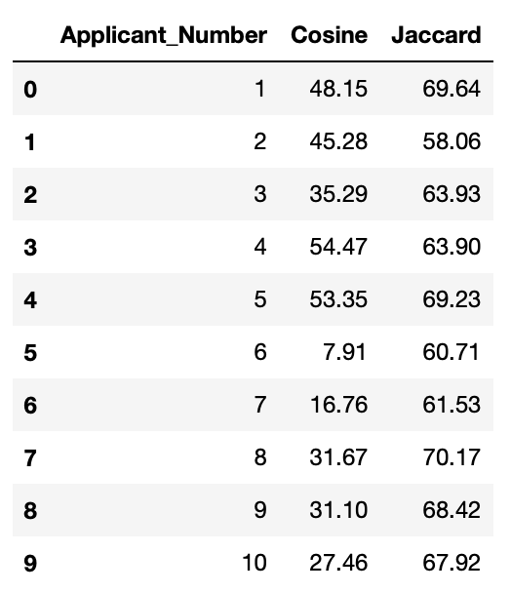
Similarity Scores using Text Summarization
Keywords

Slide 10

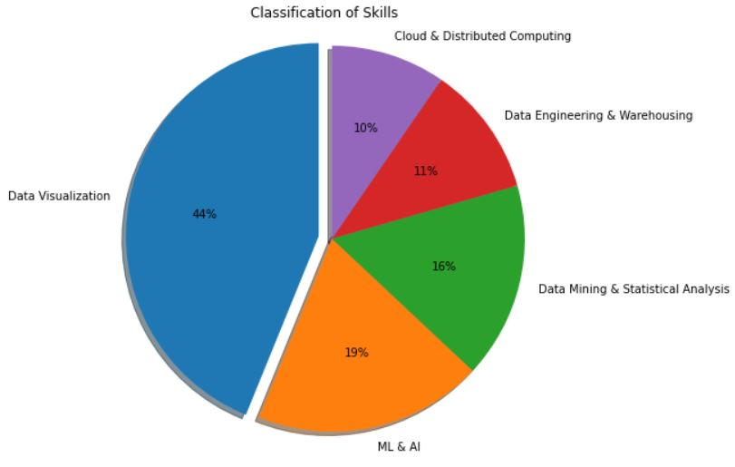
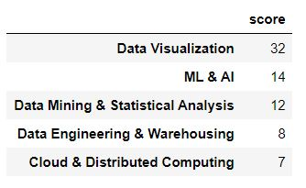
Skill-wise Classification

Slide 11

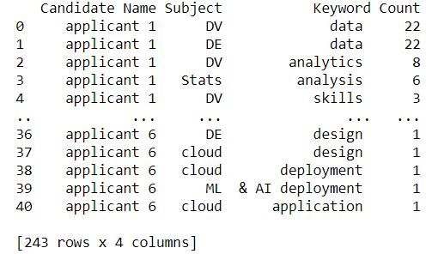
Skill-wise Comparison

Slide 12
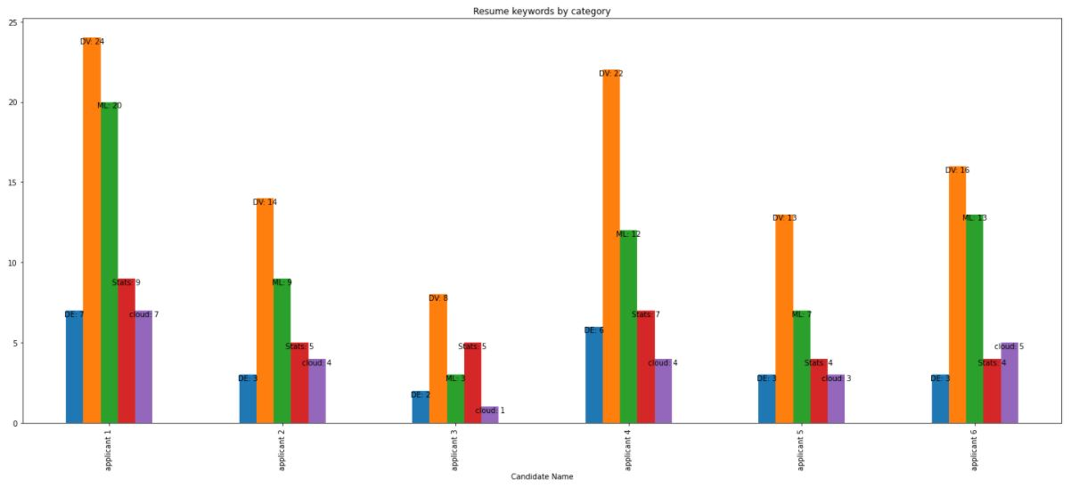
Skill-wise Comparison

Slide 13

Future Work
To find missing keywords in the Resume to increase the similarity with the job description.
Focused on data analysis, but can be extended for other industry roles.
Resumes can be checked for active action verbs.

Slide 14
Thanks!
Any questions?

Slide 15

DEMO

